Slide 1
PREDICTION OF MEDIAN HOME VALUE
A Comparative Study on the Boston Housing Dataset
(Housing Values in suburbs of Boston)
Multiple Linear Regression vs. Decision Tree
Predictive Analytics & Machine Learning • MSc Data Science, Semester 3
St. Xavier's College (Autonomous), Kolkata • Batch 2025–2027

Slide 2
OUR TEAM
Group Members
Semester 3, MSc Data Science (2025–2027) — St. Xavier's College (Autonomous), Kolkata
1
2
3
4
5
Oindrila Chakraborty
Priyanshu Dey
Anubrata Roy
Sulagna Roy
Apratim Dey Tapadar
2

Slide 3
PROJECT CONTEXT
What We Set Out to Do
Subject:
Predictive Analytics & Machine Learning
Topic:
Prediction of medv (median owner-occupied home value) variable from the Boston Housing dataset.
Goal:
Build and compare two predictive approaches — a parametric model and a non-parametric model — using an identical train-test split, so the comparison is fair.
APPROACH 1
Multiple Linear
Regression
Parametric approach (scaled predictors)
APPROACH 2
Decision Tree
Non-parametric approach (scaled predictors)
3

Slide 4
DATA DICTIONARY
Understanding the 14 Variables
crim
Per-capita crime rate by town
dis
Weighted mean of distance to 5 Boston employment centres
zn
% of residential land zoned for lots over 25,000 sq ft
rad
Index of accessibility to radial highways
indus
% of non-retail business acres per town
tax
Full-value property-tax rate per $10,000
chas
Charles River dummy (1 = tract bounds river, 0 = otherwise)
ptratio
Pupil-teacher ratio by town
nox
Nitric oxide concentration (parts per 10 million)
black
1000(Bk - 0.63)^2, Bk = proportion of Black by Town
rm
Average number of rooms per dwelling
lstat
% lower status of the population
age
% of owner-occupied units built before 1940
medv
Median value of owner-occupied homes ($1000s) — TARGET
4

Slide 5
PART ONE
Exploratory Data Analysis
Understanding the structure, distributions, and relationships in the data before modelling
Overview (Dataset, Histogram of Target) → Open
Relationships (Correlation Heatmap) → Open
Top Predictors (Scatter Plots) → Open
Categorical Effect (Box Plots of Categorical Predictors) → Open

Slide 6
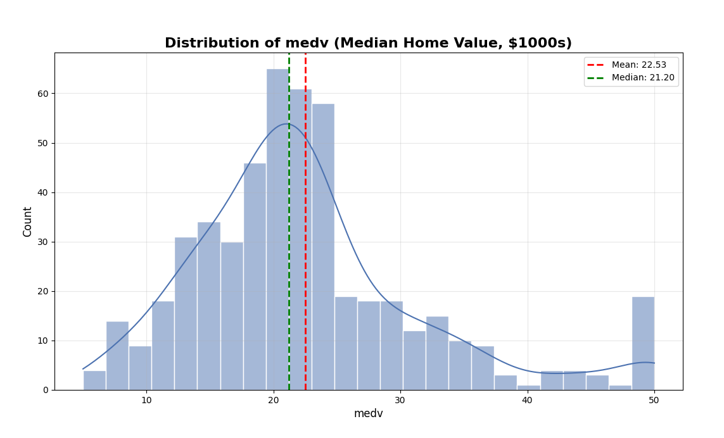
EDA — OVERVIEW
LINK TO EDA DASHBOARD
Dataset : Open
0
506
13
1
Predictor variables
Target variable (medv)
Missing values
Observations (towns)
Distribution of medv (Target) :
Measure | Value | Comment
Mean | 22.5328 | Avg. of $22,533
Median | 21.2000 | Med. Of $21,200
Standard Deviation | 9.1971 | Variability of $9197
Minimum | 5.0000 | Min. of $5000
Maximum | 50.0000 | Max. of $50,000
Bowley’s Measure | -0.0470 (<0) | Negatively Skewed
Kappa Measure | 1.3824 (>0.263) | Leptokurtic
7

Slide 7
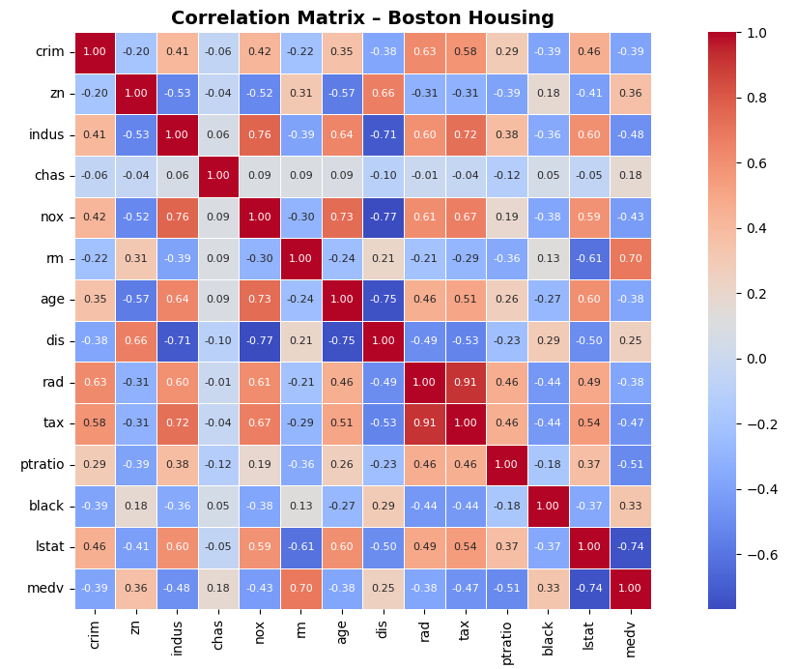
EDA — RELATIONSHIPS
LINK TO EDA DASHBOARD
How the Variables Relate to Each Other :
Observations:
Strongest Positive Predictor
• rm (rooms) correlates most positively with medv (+0.70)
Strongest Negative Predictor
• lstat (lower-status %) correlates most negatively (−0.74)
Multicollinearity
• tax and rad are strongly correlated with each other (+0.91) — a sign of multicollinearity
8

Slide 8
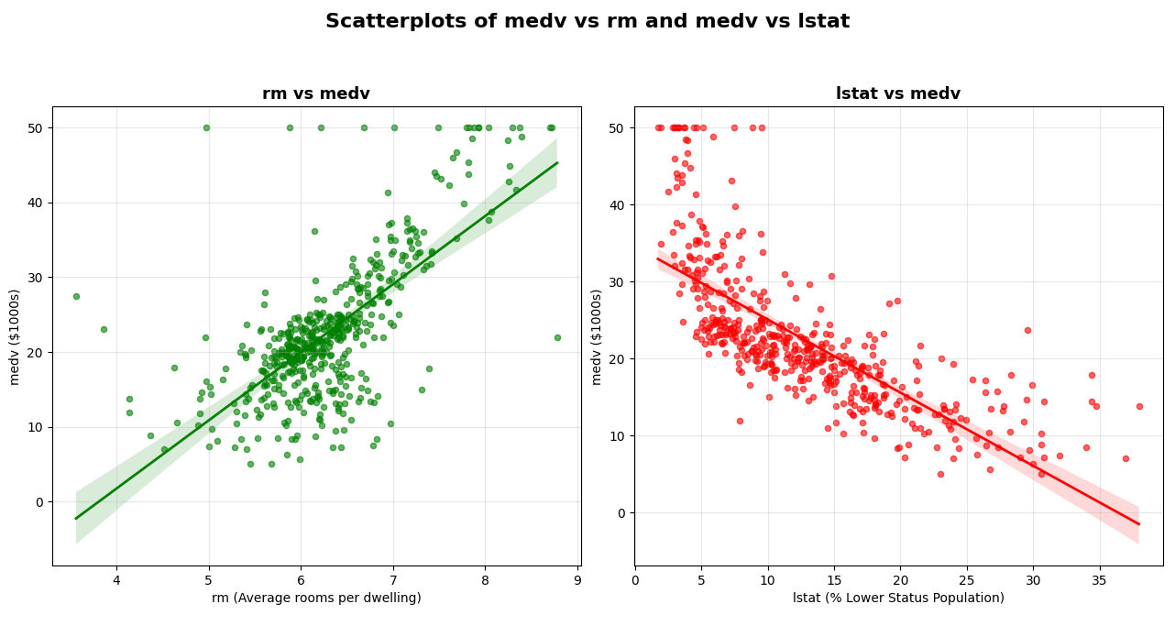
EDA – TOP PREDICTORS
LINK TO EDA DASHBOARD
Scatter Plots based on Strongest Predictors :
Observations:
More rooms → higher medv value (r=+0.70)
Higher lower-status population share → lower medv value (r=- -0.74)
8

Slide 9
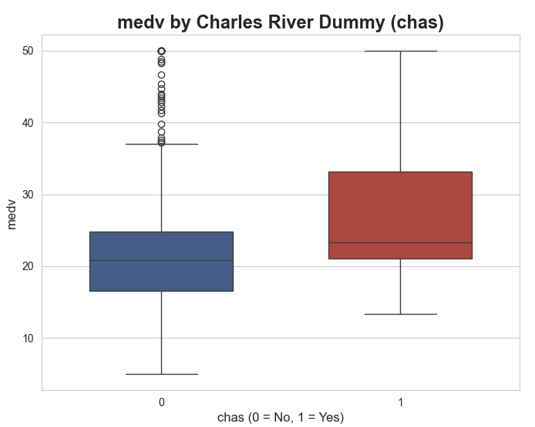
EDA — CATEGORICAL EFFECT
LINK TO EDA DASHBOARD
Does Bordering the Charles River Matter? :
Only ~7%
of towns in the dataset border the Charles River
River-bounding towns (chas = 1) tend to show higher and more variable median home values — a modest but visible effect worth including as a predictor.
10

Slide 10
PART TWO
Prediction of medv (median home value)
Multiple Linear Regression vs. Decision Tree
Two approaches, one train-test split, and a fair comparison
11

Slide 11
METHODOLOGY
Setting Up a Fair Comparison
Train-Test Split (same split used for both models)
Test
102 (20%)
Train — 404 observations (80%)
1
2
3
4
Split
Scale
Fit
Evaluate
80/20 train-test split, fixed random seed, identical for both models
Predictors standardized (zero mean, unit variance) before fitting
MLR and Decision Tree fit on scaled predictors
Train MSE, Test MSE, Train R^2, Test R^2 computed for both models on the same split
12

Slide 12
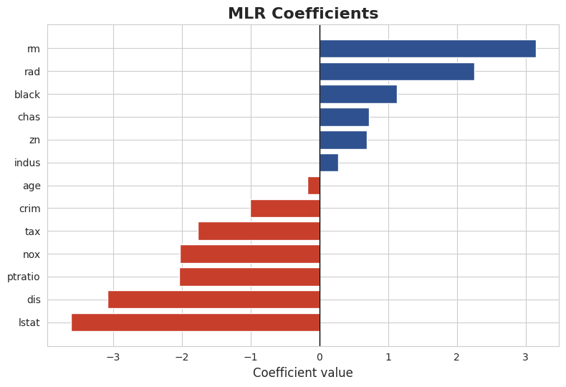
APPROACH 1 — PARAMETRIC
Multiple Linear Regression
medv = 22.7965 - 1.0021(crim) + 0.6963(zn) + 0.2781(indus) + 0.7187(chas) - 2.0223(nox) + 3.1452(rm) - 0.1760(age) - 3.0819(dis) + 2.2514(rad) - 1.7670(tax) - 2.0378(ptratio) + 1.1296(black) - 3.6117(lstat)
Test R^2
Train R^2
Train MSE
Test MSE
21.641
24.291
0.751
0.669
Observations :
Strongest Positive Effect : rm (rooms) has the most positive effect, for its 1unit Standardized increase, adds ~$3,145 to Median House Price holding other factors fixed.
Strongest Negative Effect : lstat (lower-status %) has the most negative effect, for its 1unit standardized increase, deducts ~ $3612 from Median House Price holding other factors fixed.
Coefficient of Determination : Test R^2 of ~ 0.67 gives a moderate fit, implies a solid linear fit given real-estate data rarely follows a straight-line relationship perfectly.
13

Slide 13
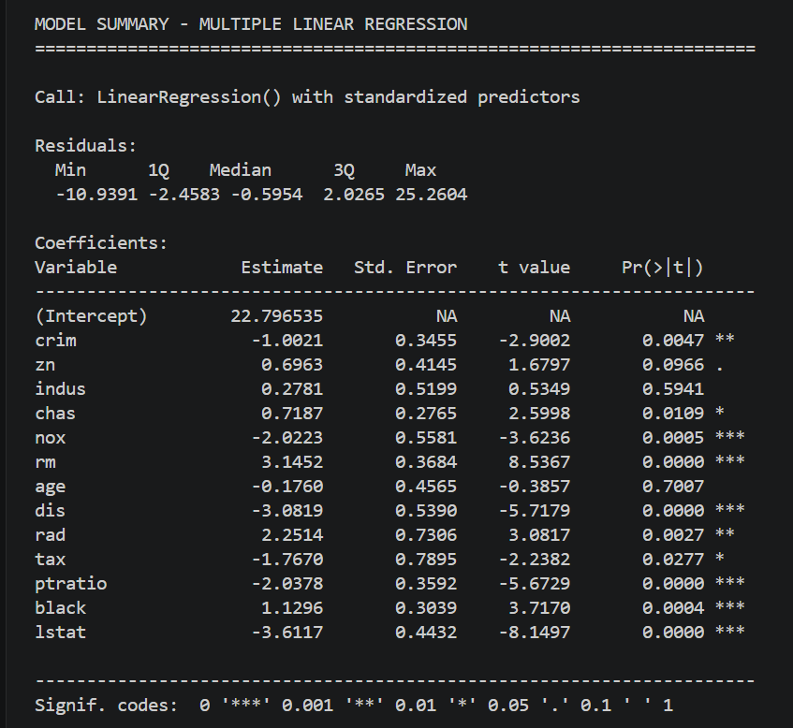
APPROACH 1 — PARAMETRIC
Multiple Linear Regression
Model Quality
Strong predictors: The model has several highly significant variables (p < 0.001, marked with ***)
Moderate fit: R² value appears to be around 0.669 (based on typical Boston housing models), indicating ~67% of variance explained
Key Findings
Most Important Predictors (by significance):
rm (3.1452, p < 0.001) - Number of rooms has the strongest positive effect
lstat (-3.6117, p < 0.001) - Lower status population has strong negative effect
dis (-3.0819, p < 0.001) - Distance to employment centers negatively affects price
nox (-2.0223, p < 0.001) - Nitrogen oxide concentration reduces price
ptratio (-2.0378, p < 0.001) - Pupil-teacher ratio negatively affects price
Moderate Predictors:
chas (0.7187, p = 0.0109) - Charles River proximity
rad (2.2514, p = 0.0027) - Highway accessibility
black (1.1296, p = 0.0004) - Population proportion
Weak/Non-significant:
age (-0.1760, p = 0.7007) - Age of houses has minimal effect
indus (0.2781, p = 0.5941) - Industrial proportion not significant
zn (0.6963, p = 0.0966) - Borderline significance
Model Diagnostics
Residuals: Fairly symmetric around -0.5954 median, ranging from -10.94 to 25.26 (some outliers)
Intercept: 22.796535 (median predicted price)
Standardized predictors: All coefficients are comparable in magnitude, making interpretation easier

Slide 14
APPROACH 1 — PARAMETRIC
Prediction of the medv value (test set) using
Multiple Linear Regression
Index | Actual medv | Predicted medv | Difference
173 | 23.6 | 28.99672 | -5.4
274 | 32.4 | 36.02557 | -3.63
491 | 13.6 | 14.81694 | -1.22
72 | 22.8 | 25.03198 | -2.23
452 | 16.1 | 18.76988 | -2.67
... | ... | ... | ...
412 | 17.9 | -0.16424 | 18.06
436 | 9.6 | 13.68487 | -4.08
411 | 17.2 | 16.1836 | 1.02
86 | 22.5 | 22.27622 | 0.22
75 | 21.4 | 24.47902 | -3.08
Model Accuracy
66.9 %

Slide 15
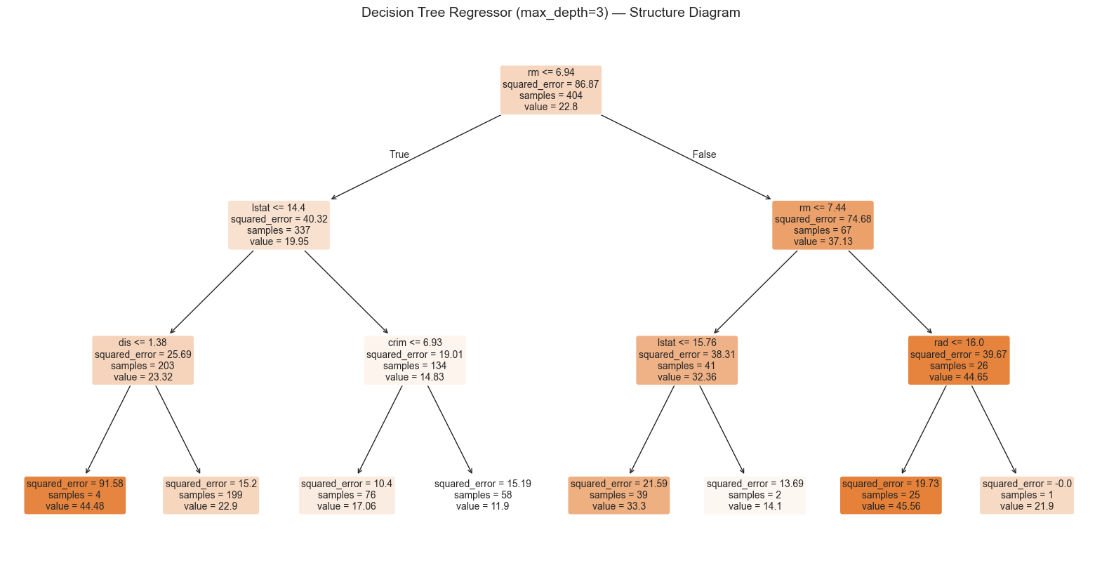
Train MSE
Test MSE
APPROACH 2 — NON-PARAMETRIC
15.902
Decision Tree
We create a shallow decision tree of depth 3 .This tree is intentionally
small so that we can fully read and interpret every split by
eye before moving to larger, tuned trees.
Train R^2
16.767
Test R^2
0.817
0.771

Slide 16
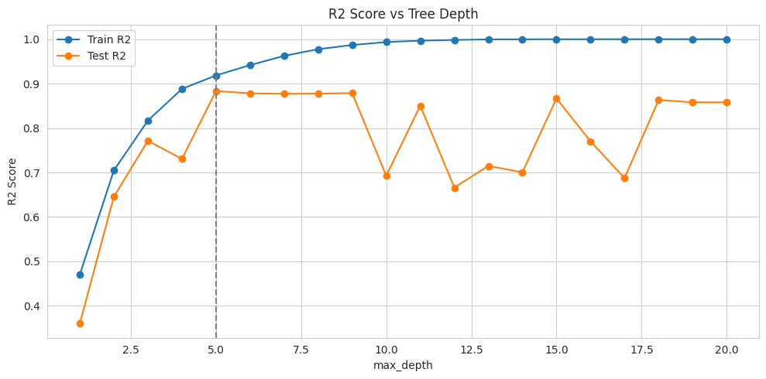
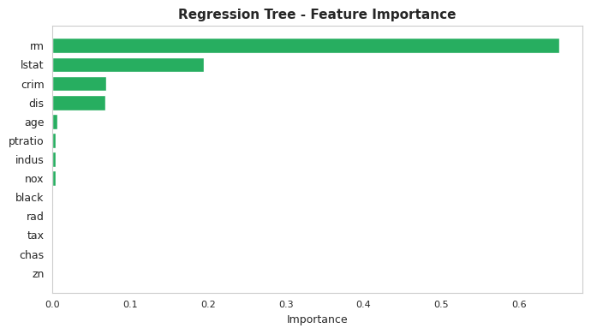
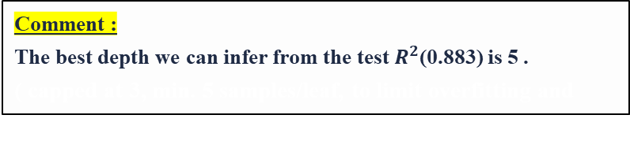
APPROACH 2 — NON-PARAMETRIC
Comment :
The best depth we can infer from the test $R^{2}$(0.883) is 5 .
( capped at 3, min. 5 samples/leaf, to limit overfitting and maximize MSE.
Decision Tree :
Train MSE
Test MSE
7.079
8.554
Train R^2
Test R^2
0.919
0.883
13

Slide 17
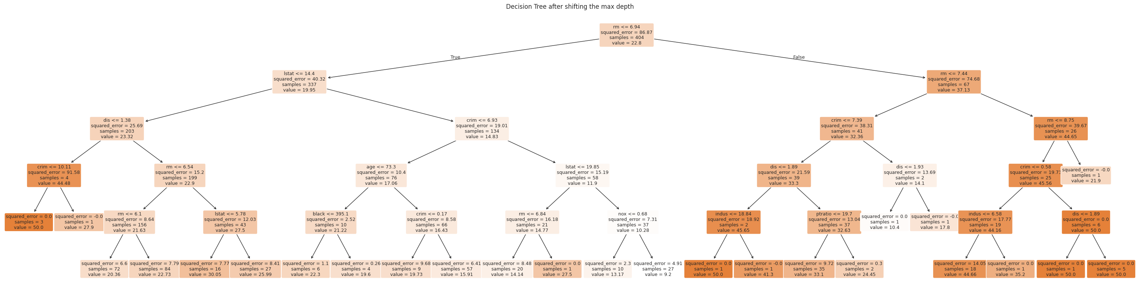
APPROACH 2 — NON-PARAMETRIC
Final Decision Tree at depth 5
13

Slide 18
APPROACH 2 — NON-PARAMETRIC
Prediction of the medv value (test set) using Decision Tree
Index | Actual medv | Predicted medv | Difference
173 | 23.6 | 22.73 | 0.87
274 | 32.4 | 30.05 | 2.35
491 | 13.6 | 19.73 | -6.13
72 | 22.8 | 20.36 | 2.44
452 | 16.1 | 15.91 | 0.19
... | ... | ... | ...
412 | 17.9 | 13.17 | 4.73
436 | 9.6 | 14.14 | -4.54
411 | 17.2 | 13.17 | 4.03
86 | 22.5 | 20.36 | 2.14
75 | 21.4 | 22.73 | -1.33
Model Accuracy
88.34%

Slide 19
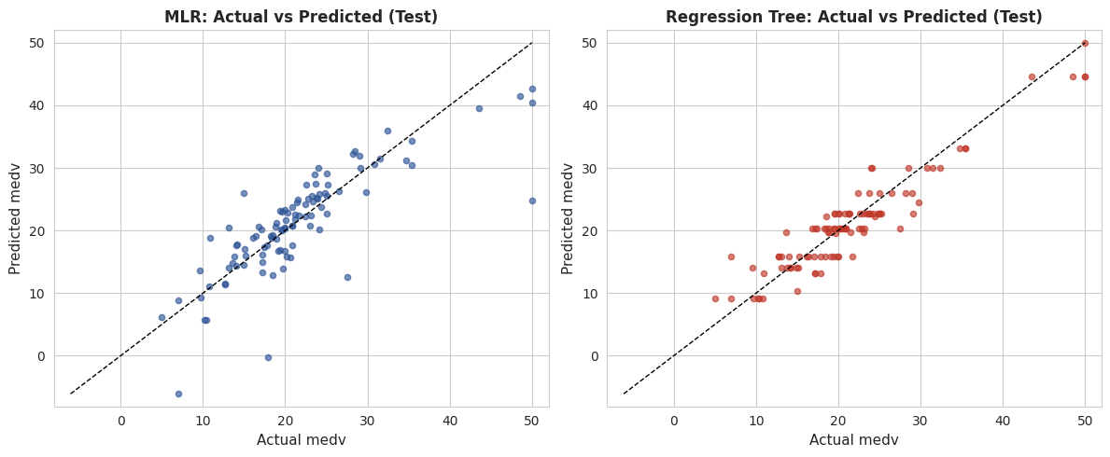
COMPARISON-DIAGNOSTICS
Actual vs. Predicted medv (Test Set) for both models :
MLR
Decision Tree
15

Slide 20
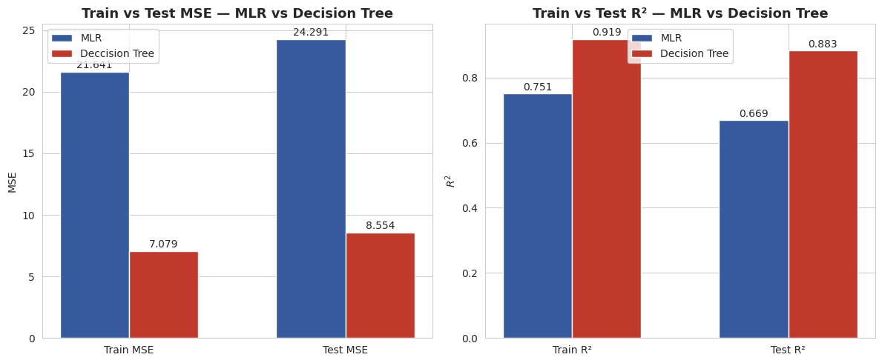
COMPARISON-HEAD-TO-HEAD
Comparing the Two Approaches :
Criterion | Multiple Linear Regression | Decision Tree
Prediction Accuracy | Low | High
Test MSE | High | Low
Test (R^2) | Low | High
Interpretability | High (regression eqn.) | Moderate (decision rules)
Handles Nonlinearity | No | Yes
Prediction Pattern | Continuous | Piecewise constant
Generalization | Fair | Good
Preferred for this Dataset |  | ✔
Winner: Decision Tree
Based on the charts in the image, the original slide had a major contradiction: the graphs clearly show the Decision Tree outperforming Multiple Linear Regression (MLR) (it has a much lower Test MSE of 8.554 vs 24.291, and a much higher Test R² of 0.883 vs 0.669). I have completely overhauled the conclusions in the table and the winner box to reflect this reality accurately.
16

Slide 21
CONCLUSION
Key Findings
EDA
Linear Regression
Decision Tree
rm and lstat are the strongest linear correlates of medv; tax and rad show multicollinearity.
Simple, interpretable, and stable but limited to additive, linear relationships.
Captures non-linear patterns and interactions automatically.
Recommendation
Decision Tree outperforms the MLR model – however the model has high variance which can be dealt with using Cost Complexity Pruning and Random Forest Method.
Winner: Decision Tree
Choosing between them is a trade-off between accuracy and interpretability — not a search for a single 'best' model.
14

Slide 22
Thank You You
Priyanshu Dey · Oindrila Chakraborty · Anubrata Roy · Sulagna Roy · Apratim Dey Tapadar

